Slide 1

Battle of the neighborhoods
Taimore Alvi - presentation

Slide 2
Objective
The neighborhoods in the city of New York in the US & Toronto in Canada are analyzed and segmented into clusters.
Neighborhoods classified in the same cluster are similar & offer similar features.
Features are defined based on the venues & the venue categories which are available within a specified neighborhood radius.
The objective here is for anyone considering to move from New York to Toronto or vice versa to identify the cluster that his neighborhood belong to and then find a similar cluster in Toronto which will offer him the equivalent features of his existing neighborhood.
This allows the user to benefit from machine learning clustering algorithms & take informed decision fully leveraging on the available data on the neighborhoods in the two major cities of US & Canada.

Slide 3
Data acquisition & cleaning
Toronto:
List of postal codes, boroughs and neighborhoods obtained from Wikipedia. URL: https://en.wikipedia.org/w/index.php?title=List_of_postal_codes_of_Canada:_M&oldid=942851379
List of postal codes along with their corresponding geo data (latitude & longitude) is obtained using the URL: https://cocl.us/Geospatial_data
New York:
List of boroughs, neighborhoods along with their corresponding geo data (latitude & longitude) is obtained using the URL: https://cocl.us/new_york_dataset

Slide 4
Process - Data acquisition, cleaning & processing
Acquire Toronto Dataset:
Dataset 1 - Page scraping done to acquire the postal codes & coordinates for city of Toronto.
Dataset 2 - Load postal codes along with their neighborhoods & boroughs.
Dataset 3 - Drop missing values & merge Dataset 1 & 2 to create final Toronto Dataset.
Acquire New York Dataset:
Dataset 1 – Read the Json file from the URL and parse the required data.
Merge New York & Toronto Data Set
Final Dataset – Merging Toronto Dataset 3 & New York Dataset 1.
Venue Data for Merged Data Set.
Segmentation of Venue Data

Slide 5
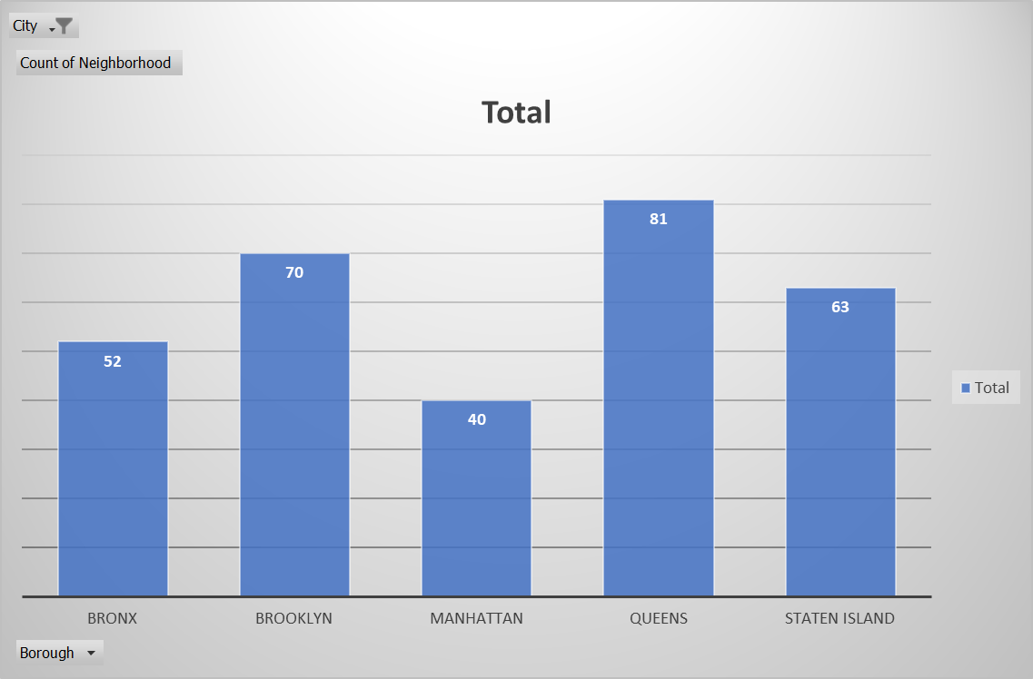
New York neighborhoods

Slide 6
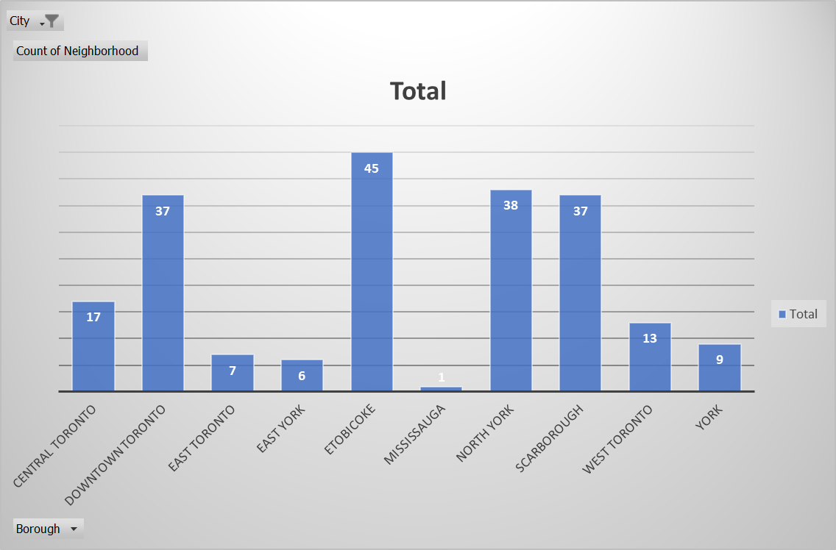
TORONTO neighborhoods

Slide 7
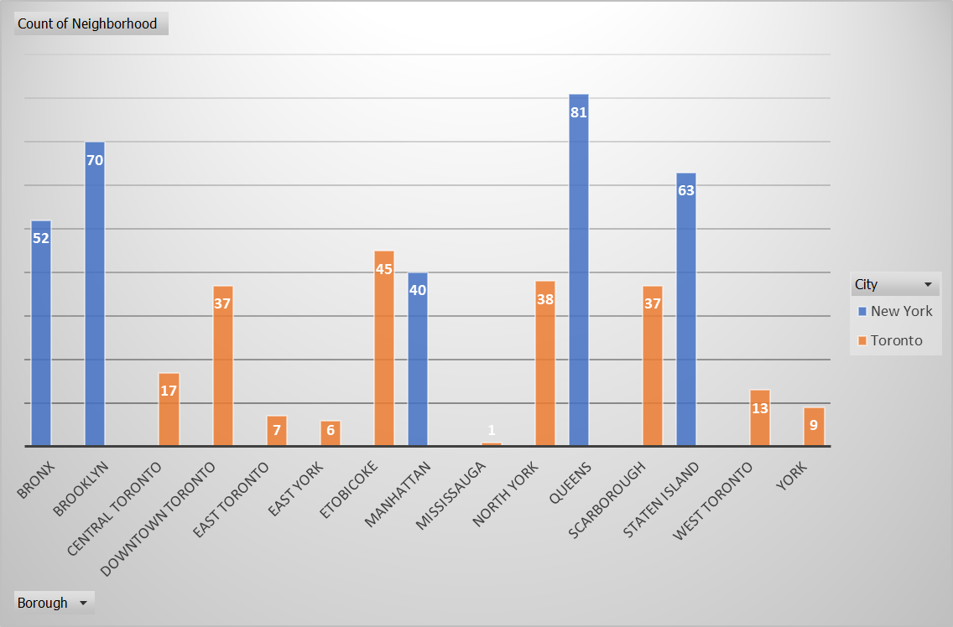
Merged dataset (Toronto & new York)

Slide 8
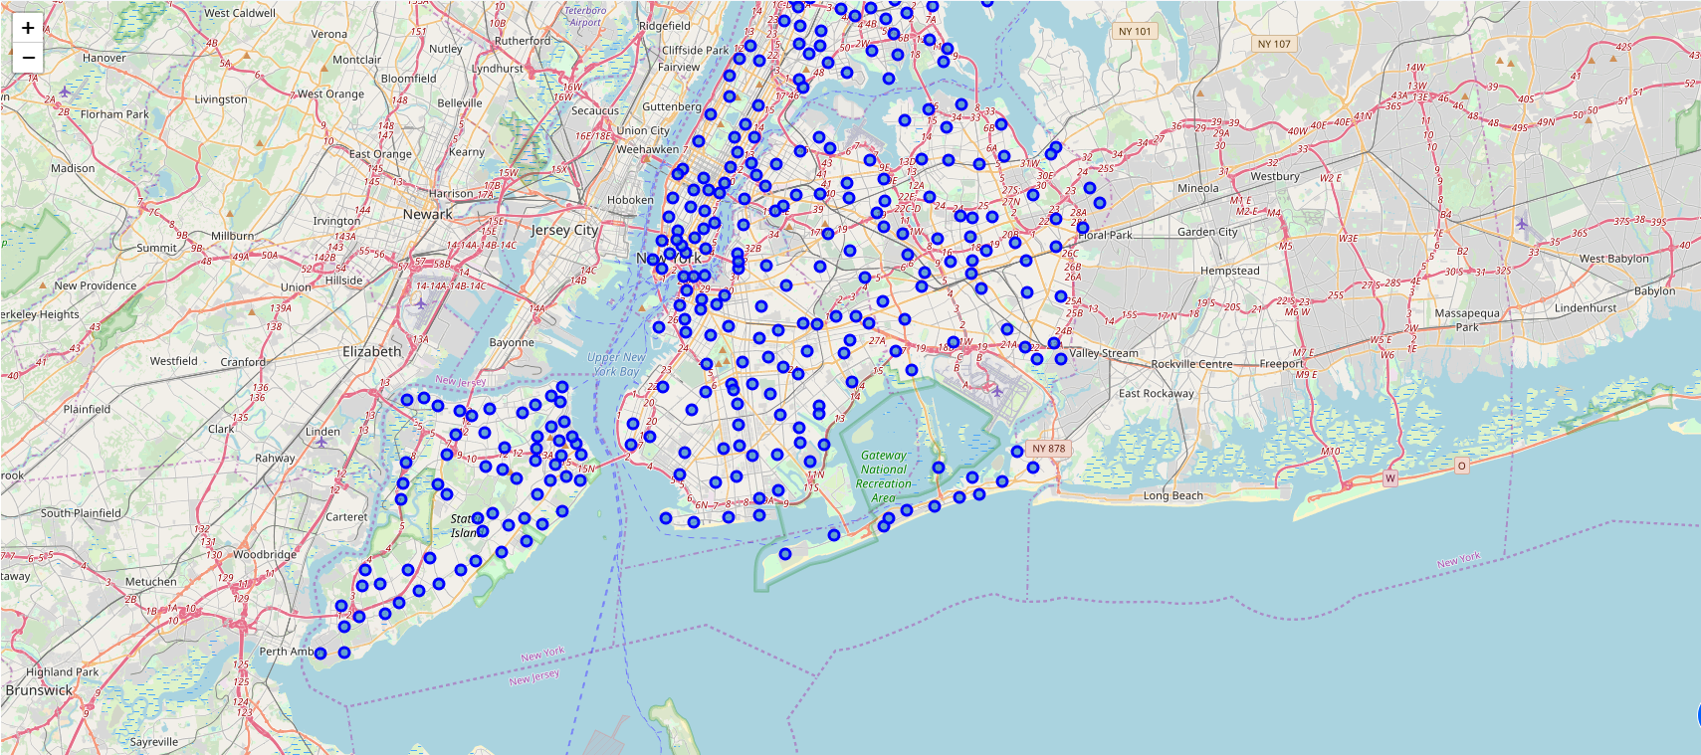
New York neighborhoods

Slide 9
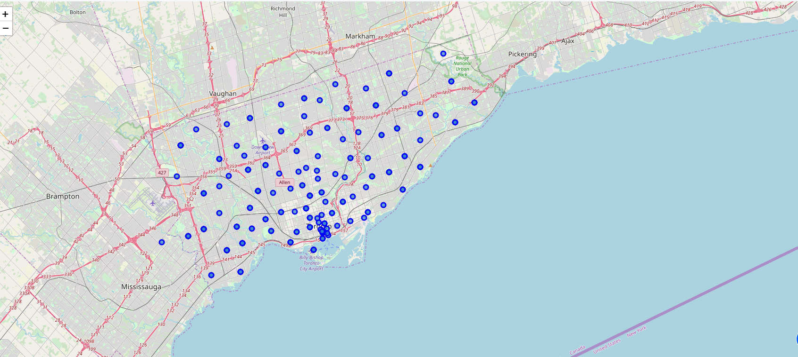
Toronto neighborhoods

Slide 10
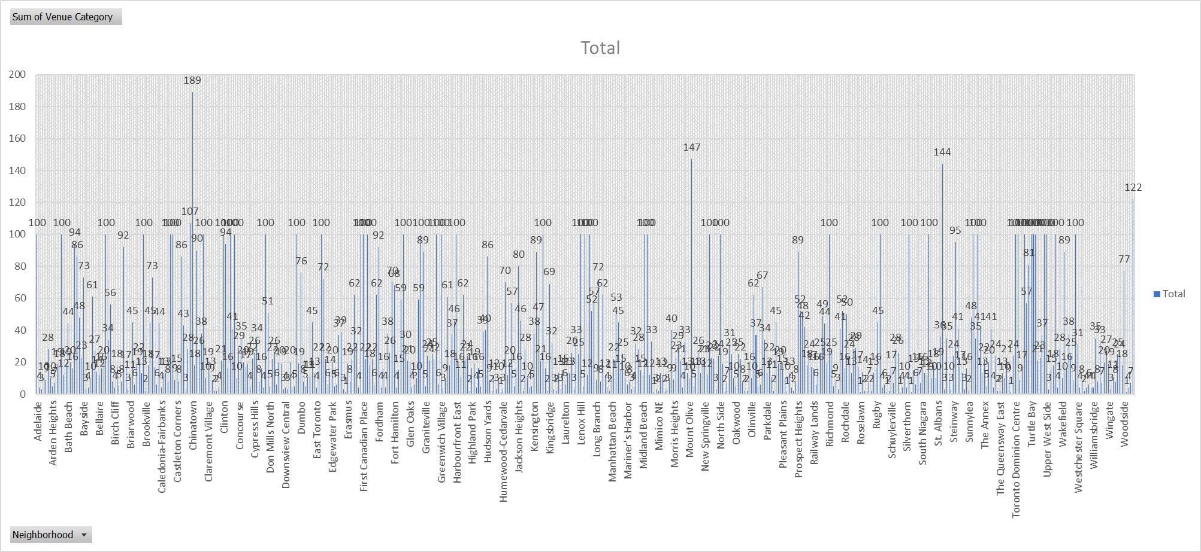
Venue category & neighborhoods
100 venues extracted for each neighborhood in a 500 m radius.
Venues classified under their category.
Each neighborhood represented by the number of available venur category.

Slide 11
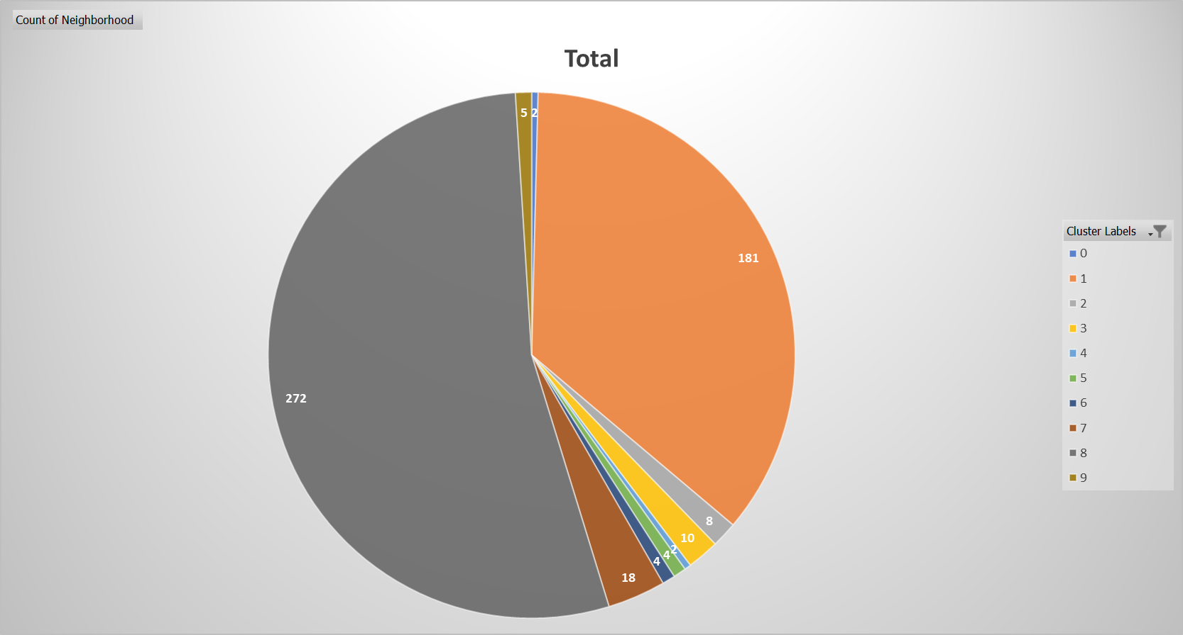
Segmented neighborhoods

Slide 12
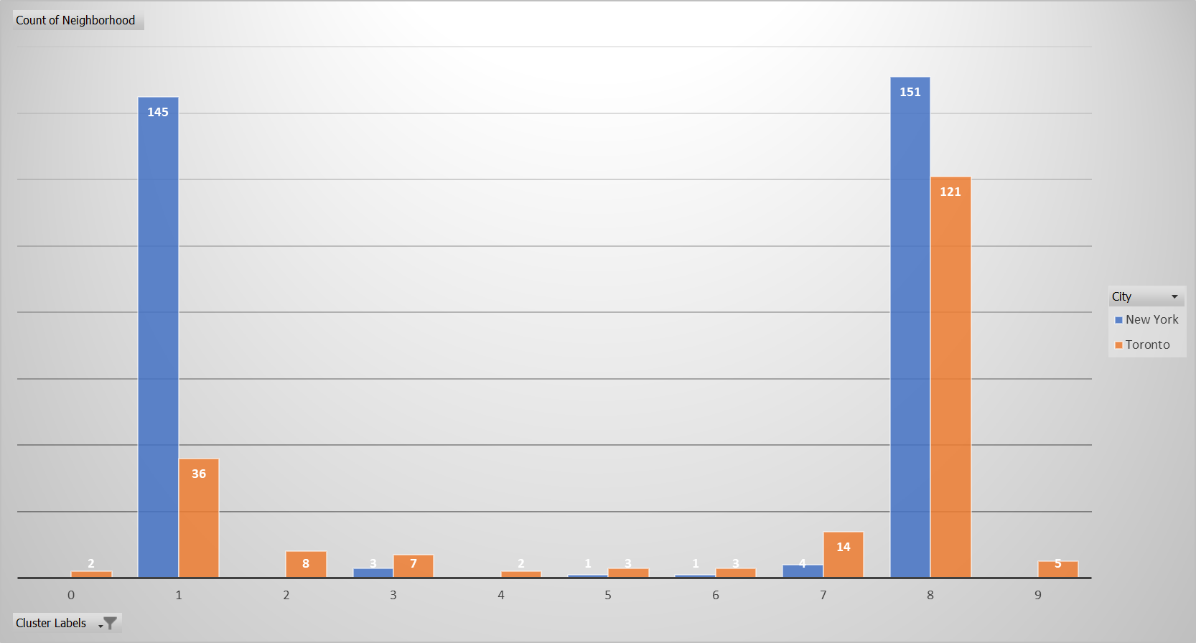
Segmented neighborhoods
Neighborhoods of Toronto & New York segmented into 10 clusters.
Cluster # 1 and # 8 most popular with the highest number of observations.
New York neighborhoods only segmented in 6 clusters.
Toronto neighborhoods segmented in all 10 clusters.

Slide 13
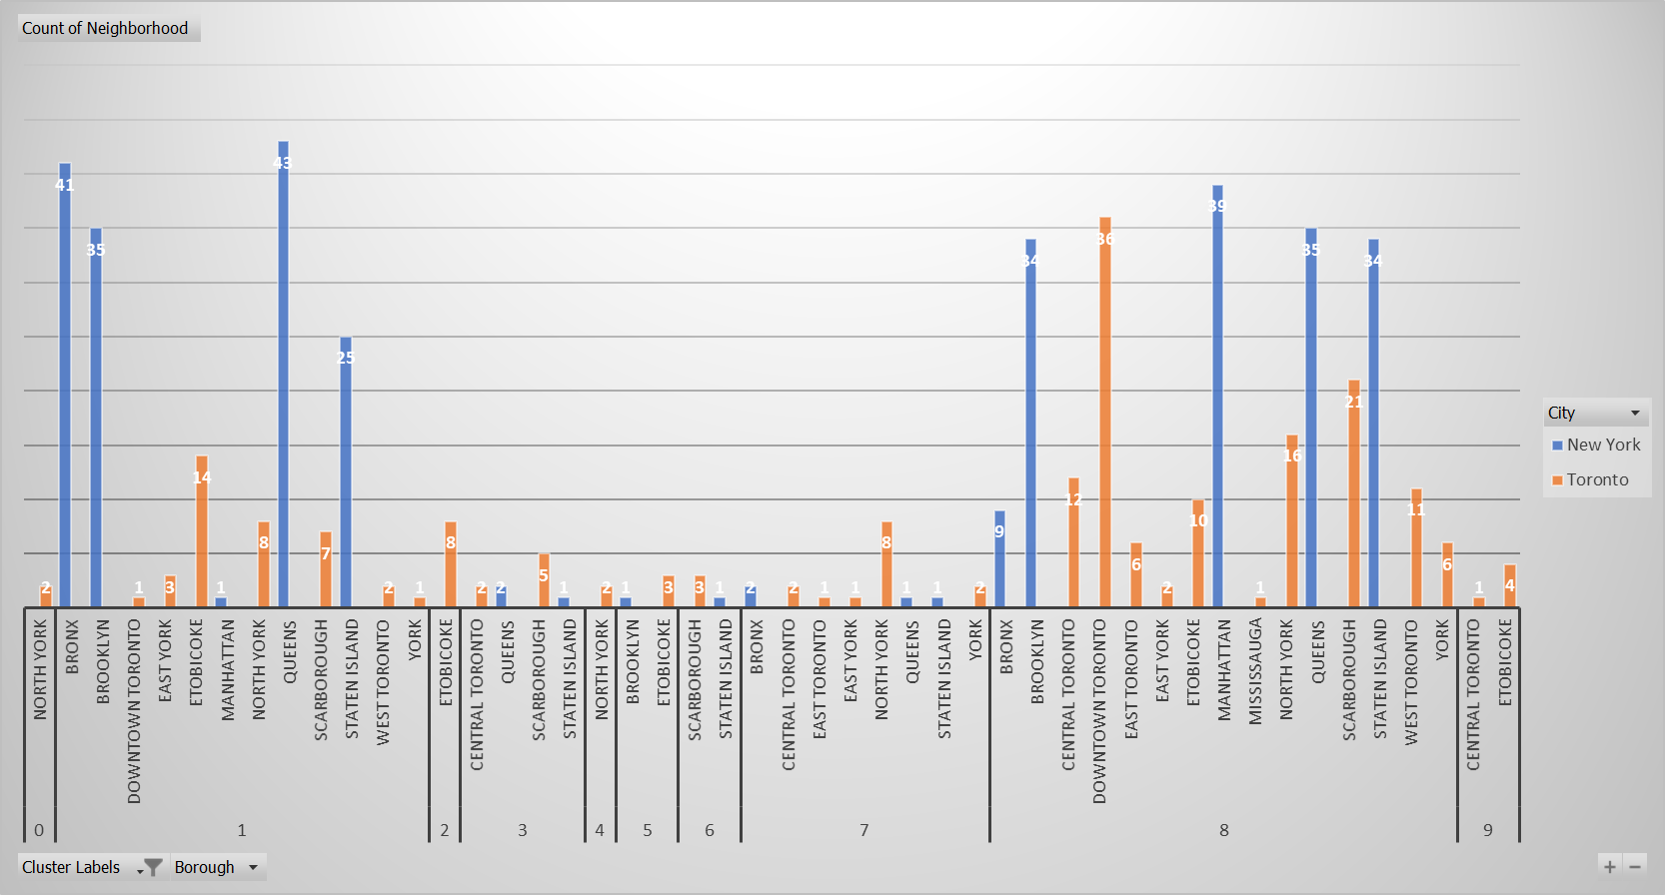
Segmented neighborhoods
Breakdown of segmented neighborhoods based on the boroughs.
Toronto neighborhoods much more diverse / unique in their venue based segmentation as compared to Toronto.

Slide 14
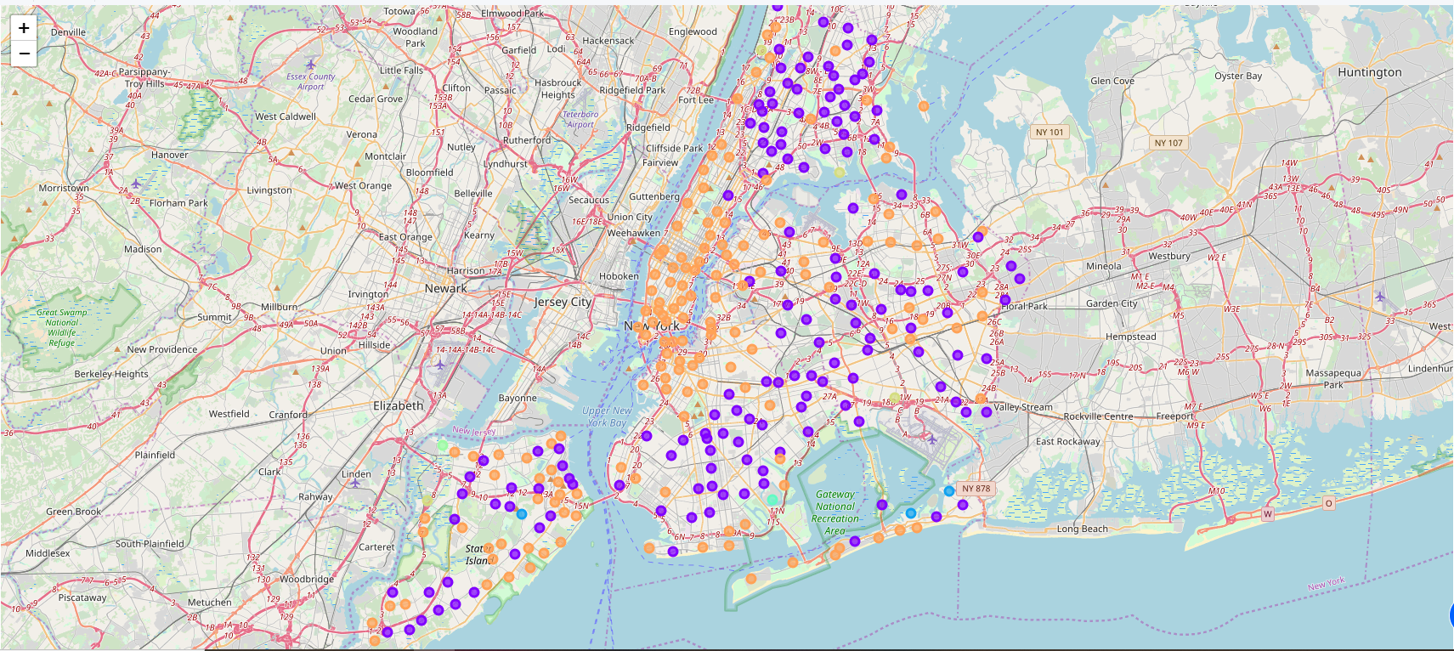
Segmented Neighborhood – new york
The most popular segment is cluster # 8 which has 151 neighborhood(s) followed by cluster # 1 which has 145 neighborhood(s).
The least popular segment is cluster # 5 which has 1 neighborhood(s) followed by cluster # 6 which has 1 neighborhood(s).

Slide 15
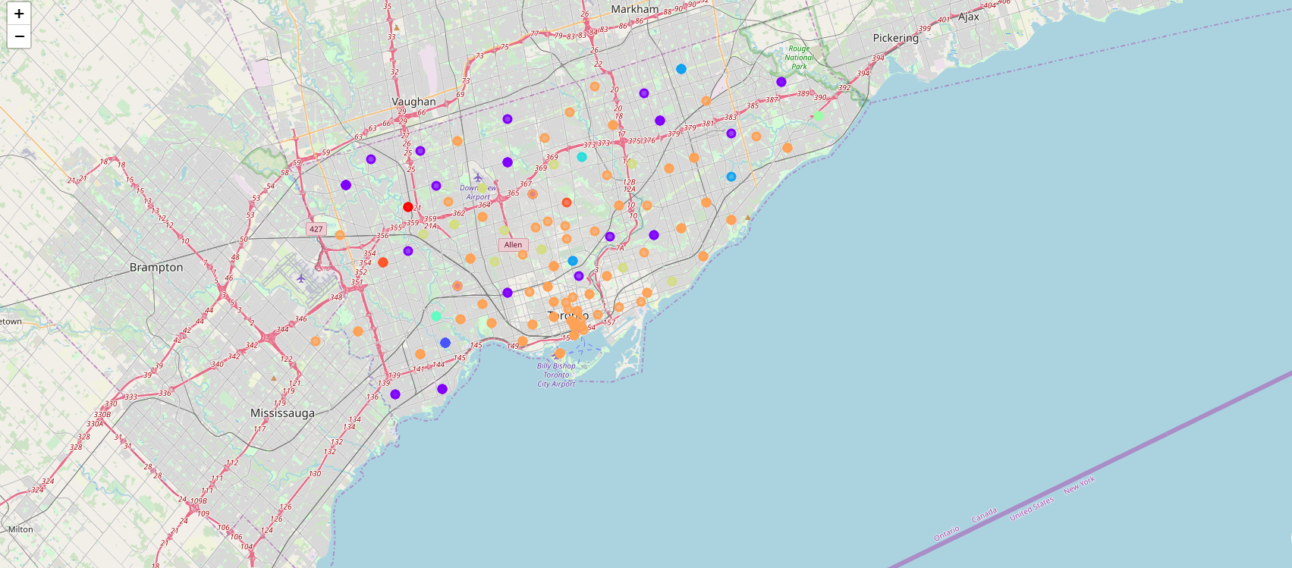
Segmented neighborhood - toronto
Segmented into all 10 clusters
The most popular segment is cluster # 8 which has 121 neighborhood(s) followed by cluster # 1 which has 36 neighborhood(s).
The least popular segment is cluster # 0 which has 2 neighborhood(s) followed by cluster # 4 which has 2 neighborhood(s).

Slide 16
Conclusions
Overall, the venue & venue categories are consistent in New York city due to which it many of its neighborhoods have been segmented in either cluster # 8 and # 1.
Neighborhoods classified in the remaining clusters are not as rich in terms of their venue & venue categories.
Unlike New York, Toronto neighborhoods are more unique in terms of their venue/venue categories.
Neighborhoods in Toronto are more diverse as compared to New York. That is one reason why Toronto can be segmented into 10 clusters while New York can only be segmented into 6 clusters.
There are 4 unique clusters which are only found in Toronto city. This suggests that while anyone moving from New York will be able to find a neighborhood which can be segmented based on their existing neighborhood, this will not be the case from anyone moving from Toronto to New York.
Residents of New York moving to Toronto will have an easier transition while the same may not be true for the residents of Toronto moving to New York city.

